Slide 1


First Loan Tax Exempt Training
idahohousing.com

Slide 2
First Loan-Tax Exempt

Slide 3

Tax Exempt Mortgage Revenue Bonds
Mortgage Revenue Bond (MRB) are financing tools used by state housing finance agencies (HFAs) to finance low-interest mortgages for low- and moderate-income home buyers. Investors in mortgage revenue bonds are willing to accept a lower rate of return because the interest on the bonds is exempt from federal income tax. *
This allows IHFA to offer a Tax Exempt MRB loan program with interest rates up to 1% below market rates,
and sometimes lower!
*Source: https://www.ncsha.org/wp-content/uploads/Housing-Bonds-FAQs-2022.pdf

Slide 4
First Loan-Tax Exempt Loan Program
Must be a First Time Homebuyer – except in Targeted Counties – Not had ownership in a primary residence in the last 3 years preceding closing.
Owner Occupied
Single Family dwelling –Manufactured allowed – 2-4 Multi Unit allowed
May be paired with Second Mortgage
Income limits
  Follow First Loan- Tax Exempt Income Limits
  Household Income
  Non-Occupying Co-Borrowers Not Allowed

Slide 5
Annual Gross Household income is the total of all sources of income from anyone:
  On title
  All spouses, whether borrowing or non-borrowing
  All other adult individuals 18 years or older who will both occupy the residence and be liable (primarily or secondarily) on the deed, mortgage, or note
This income calculation methodology is applied to each loan to accurately and completely measure the household’s total gross income for the prospective 12 months (in the future) from the application date.

Slide 6
Income to be included in household income calculation:
Base
Overtime, Bonus & Commission
Social Security Income
Alimony and/or Child Support
  Pensions, Annuities, Disability, or Death Benefits or Long-Term Care Insurance
Recurring Cash Allowances & Gifts
Business Income
Interest / Dividend Income
Other Income: tips, unemployment income, seasonal employment, National Guard, supplemental income
Payments in lieu of earning : unemployment, disability compensation, worker’s compensation, severance pay, welfare assistance

Slide 7
Some Income Exclusions may apply
Including but not limited to the following:
Payments received for care of foster children or adults
Lump-sum additions to family assets,
  such as inheritance, insurance payments
Amounts received by household that are specific reimbursements for expenses

Slide 8
Household Income vs Qualifying Income
Household – Projected 12 months
Qualifying – Past
Annual Gross Household Income – projected income from loan application date forward 12 months
To determine full-time income multiply:
Hourly wages by 2080
Weekly wages by 52
Bi-weekly wages by 26
Semi-monthly wages by 24
Monthly wages by 12
To determine Annual Gross Household Income for less than full-time employment, multiply:
Hourly wages by the number of hours the person is expected to work per week X 52
If a range of hours is given, you must use the highest number of hours. If this puts the HH income over limits, you may need to contact the employer and clarify. If the hours are irregular, average the number of regular hours at current regular pay rate and average the overtime hour’s times current overtime rate.

Slide 9
Lenders must determine the household earnings for the “current period”. The “current period” begins with the pay period prior to the date of the loan application an ends at loan approval.
If a VOE reflects a raise within the first 12 months of loan, the raise must be considered in calculations.
Part-Time Employment –
Average of hours worked in “current period” by regular rate of pay.
If a VOE reflects differently, you must use the higher of the two.
Overtime -
To calculate overtime for compliance purposes, first consider the amount earned during the "current period" and annualize it.
If the Borrower claims that the overtime earned in the "current period" is excessive or unusual, the Mortgage Lender may average the number of hours of overtime worked during the previous two years. Multiply the average monthly hours by the current rate of overtime pay and use that figure for overtime earnings.

Slide 10
Bonus: The gross amount of a recurring bonus before any payroll deductions is to be included in the income calculation when the following applies:
a) The bonus is included in the computation of income by the employer; or
b) There is a history of bonuses.
If the information is available, the amount of the bonus income to be included for compliance is the bonus paid or payable for the calendar year in which the loan is closed.
Commissions: Income derived from commissions should be based on the "current period" unless evidence is provided which justifies averaging the commissions.

Slide 11
Self-employment: The procedure for calculating Annual Gross Household Income for self-employed applicants is the same as under FHA, VA or Fannie Mae underwriting guidelines. As in standard underwriting, depreciation and depletion are to be added back to determine annual income. Tax returns, a current financial statement, current P&L Statement and a self-employed cash flow analysis are required for all self-employment applicants. Two years signed corporate, or partnership tax returns are required in addition to personal returns.

Slide 12
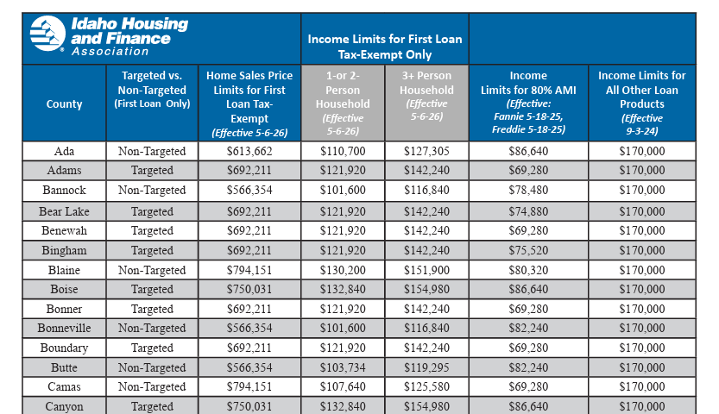

Slide 13
Required Documentation
First-time homebuyer is verified using the credit report and/or borrower attestation.
Required Documentation:
  IHFA Borrower Affidavit and Lender/Broker Certification 12/2024
  Recapture Notice 05/05/2025
  Recapture Summary 12/2024
  Recapture Reimbursement 12/2024
  Sellers Affidavit 12/2024
  Tax Exempt Rider 12/2024
  Required to be attached to the Deed of Trust
  Income Certification Worksheet 12/2025
All required documents* are available on the homepage of the IHFA Lender Connection website, Plan codes also available through Encompass
*Note – You must use the most recent versions of required documents. No previous versions of these documents will be accepted. Please keep in mind when Income Limits change in April/May of each year, the Recapture Notice schedule will change. See above for each document specific dates.
All must be fully executed prior to or at closing.
These documents must be included in the Loan File for IHFA review. Loan will not be sent for Compliance Review until ALL required documents have been submitted.

Slide 14
Post Close Compliance Review
All First Loan Tax Exempt Loans are subject to a Post Close Compliance Review prior to IHFA Purchase.
The following items will be reviewed for program guideline adherence
First Time Homebuyer Status
Targeted County vs Non-Targeted County
Household Income
  Household Income worksheet to be included in Loan File for Review
  Include: (for all liable occupants)
  current pay stub or applicable income verification such as a
  Benefit Statement to verify Social Security Income
Adherence to Purchase Price Limits (as well as Acquisition costs)
Properly completed documents, i.e. Tax-Exempt Rider, Recapture documents (revision date of 12/24)

Slide 15
All must be fully executed prior to or at closing.
These documents must be included in the Loan File for IHFA review.
Loan will not be sent for Compliance Review until
ALL required documents have been submitted.

Slide 16
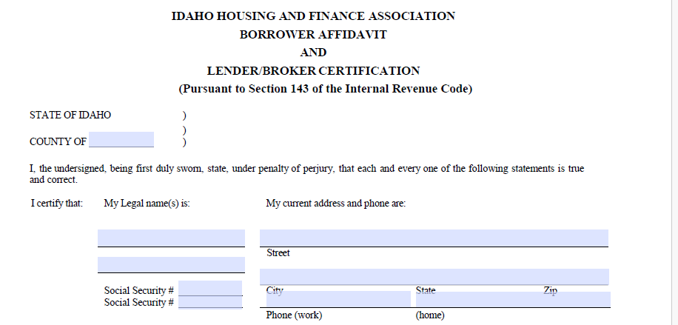
County Property is Located In
Completely fill this section out

Slide 17
Address of property being financed
Acquisition Cost
Acquisition Cost The cost of acquiring a principal residence as a complete residential unit. All amounts paid, either in cash or in kind, by the purchaser (or a related party for the benefit of the purchaser) to the seller (or a related party for the benefit of the seller) as consideration for the residence but not including usual and reasonable settlement costs. If a residence is incomplete, the reasonable cost of completing the residence should be included; however, it shall not include the value of services performed by the borrower or members of the borrower’s family in completing the residence.

Slide 18
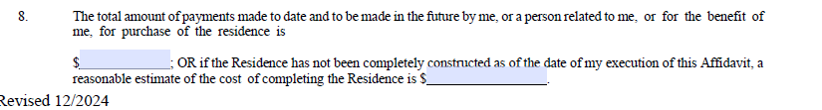
  Enter Total Acquisition Cost in first blank field unless the subject property is still under construction on the day this document is fully executed.
If subject property is still under construction on the day this document is fully executed, then the Estimated Total Acquisition Cost should be entered in the second blank field.

Slide 19
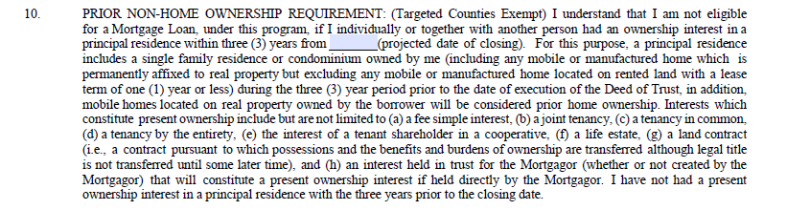
Closing date

Slide 20
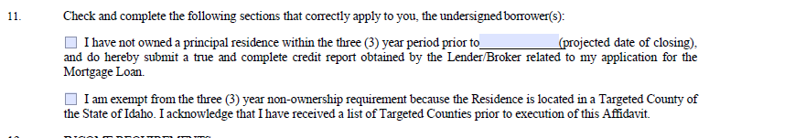
Make sure the correct line item is checked, do not leave a section incomplete

Slide 21
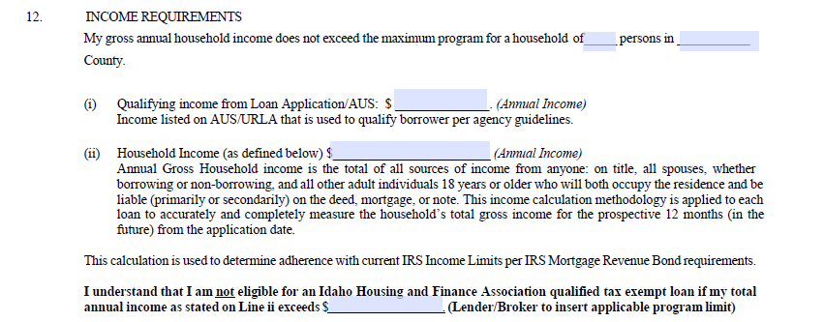
Monthly X 12 1003 Income
Income Limit for respective County

Slide 22
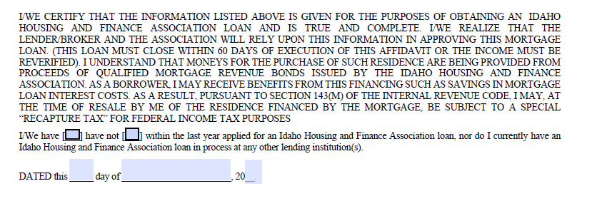
Do not forget to check the appropriate box

Slide 23
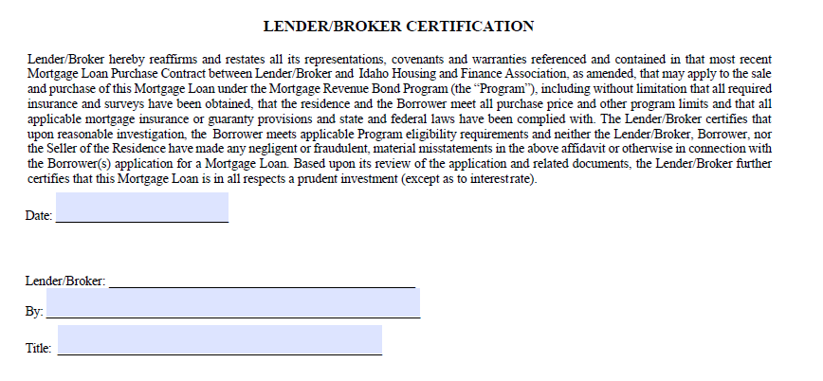
This is a commonly missed section of the document.
This must be completed for Compliance Approval.
Signature of Lender/Broker
Name of Signer
Title of Signer

Slide 24
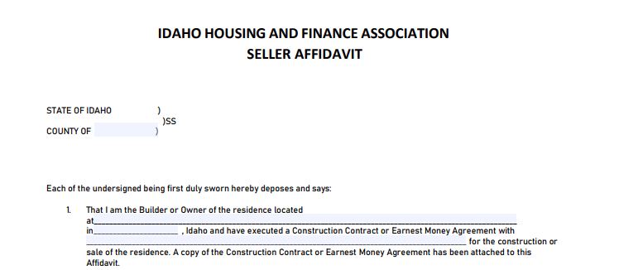
County Subject property is located in
Subject property City
Street Address, subject property
Borrowers' names

Slide 25
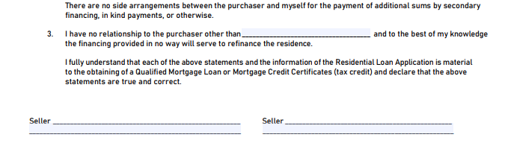
Acquisition Cost
“Seller” or additional relationship if applicable
Seller's name typed below Signature Line

Slide 26
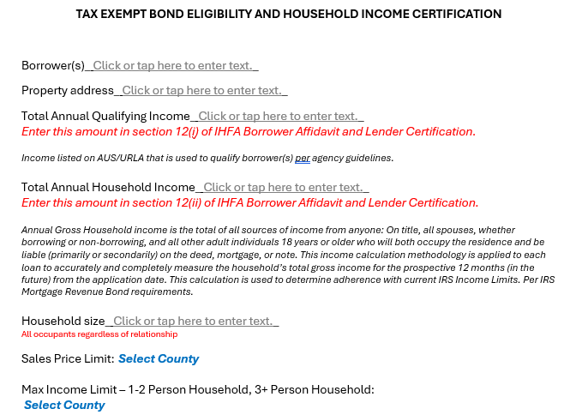
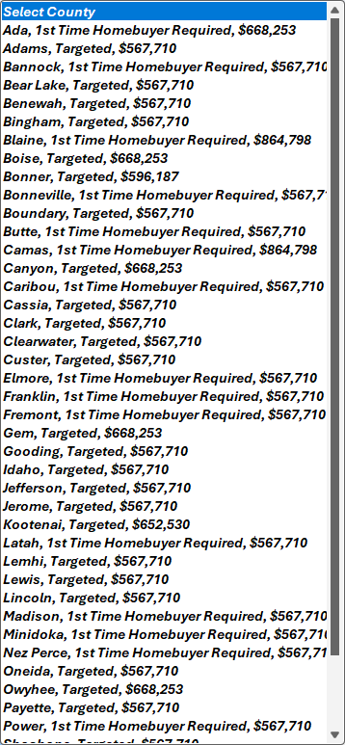

Slide 27
Income Worksheet is available in the Encompass Plan Code for this loan program
Unfortunately, we were unable to make this form interactive on this platform.
Requirements for filling it out do not change. Please make sure the document is fully executed. Underwriter acknowledgement must be on document for it to be accepted.

Slide 28
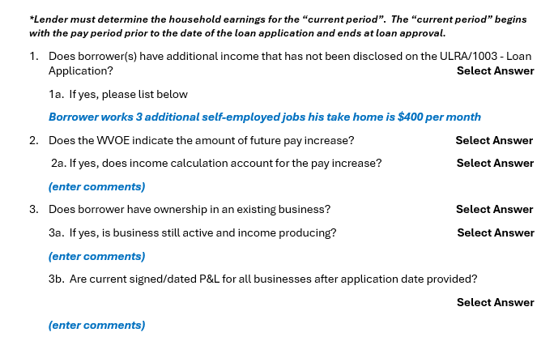

Explanation of additional income source

Slide 29
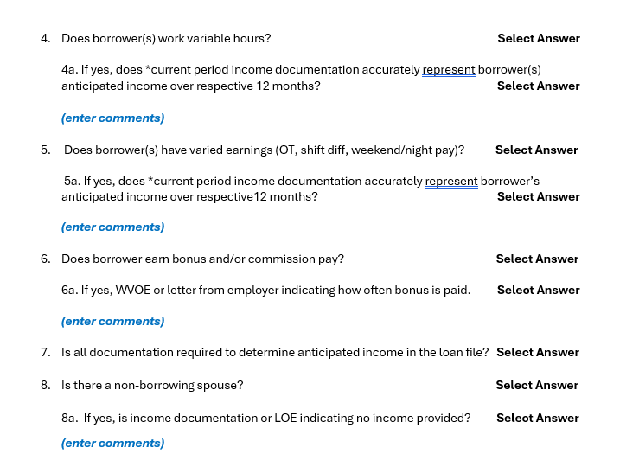

Slide 30
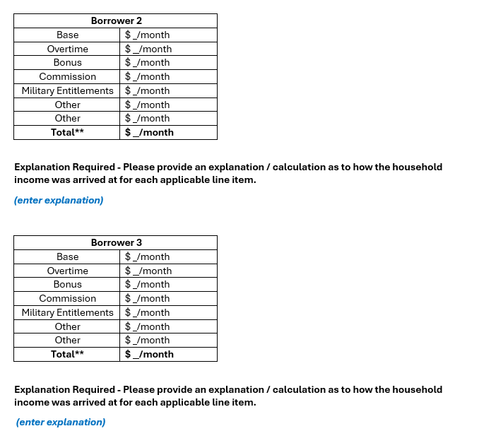
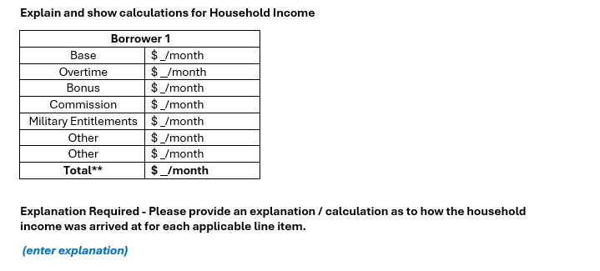

Slide 31
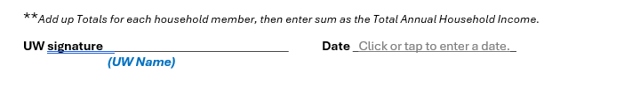
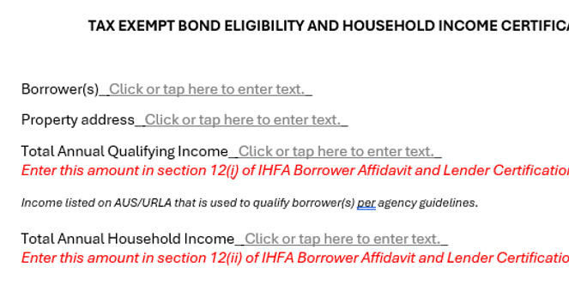

Slide 32
Key Take Aways
Definition of Household Income:
Annual Gross Household income is the total of all sources of income from anyone: On title, all spouses, whether borrowing or non-borrowing, and all other adult individuals 18 years or older who will both occupy the residence and be liable (primarily or secondarily) on the deed, mortgage, or note. This income calculation methodology is applied to each loan to accurately and completely measure the household’s total gross income for the prospective 12 months (in the future) from the application date.
Current Period:
Lender must determine the household earnings for the “current period”. The “current period” begins with the pay period prior to the date of the loan application and ends at loan approval.

Slide 33
Key Take Aways (Continued)
First Loan TE Program Specific Income Limits:
Ensure IRS Income Limits are adhered to – keep in mind these are County specific. Based on Targeted, non-Targeted Counties as well as size of household, 1-2 Household size and 3+.
Document Requirement: All required documents, TE Rider, Borrower Affidavit, Recapture Summary, Recapture Notice, Recapture Reimbursement, Seller Affidavit & Income Certification dated. No other documents will be accepted. Encompass program codes have been updated with correct documents.
Compliance Approval:
It is essential that all the items associated with this training are adhered to. A messy incomplete loan file will delay the turn times drastically. Remember Qualifying Income is not the same as Household Income.
Please reach out with Questions

Slide 34
It is imperative that all documentation is completed correctly.
Tax Exempt Rider MUST be recorded with the Deed of Trust
Recapture Docs MUST be fully filled out, signed and dated prior to or at closing
Use only documents with the proper issue dates.
Household income calculation is NOT the same as Qualifying Income
Please review parameters of Household Income Calculations

Slide 35
Please reach out with Questions
ResLoan@ihfa.org
JohnL@ihfa.org
RitaA@ihfa.org

